Slide 1


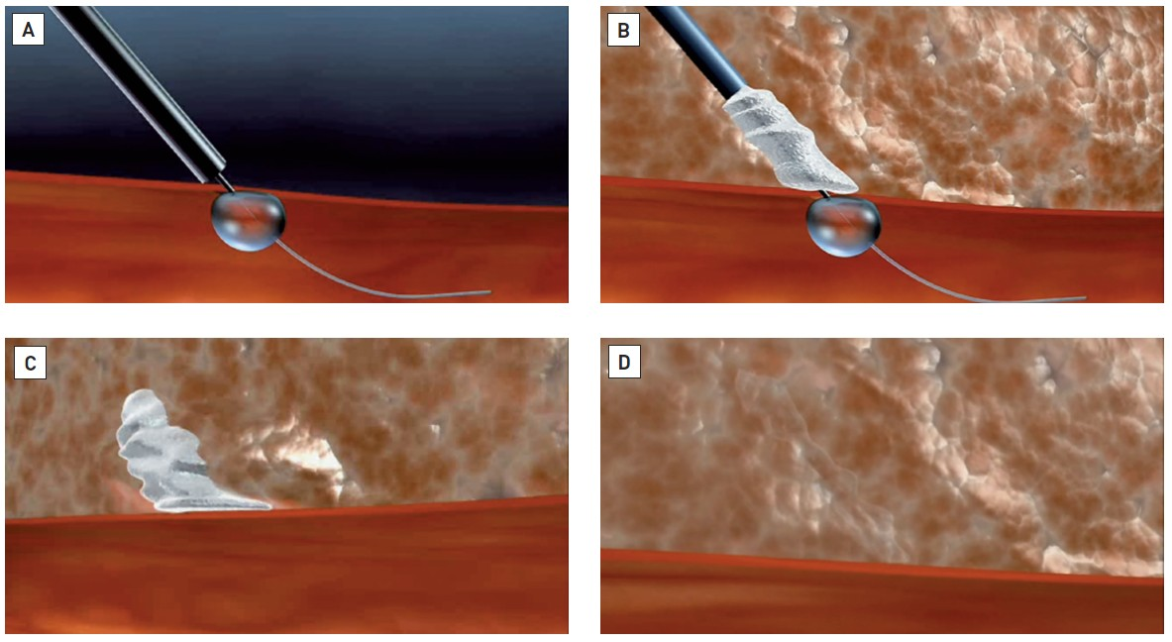

Vascular closure
Figure 14
Stages in the deployment of the Mynx® device (see text for panel detail)
Marie-Claude Morice, Maya Riche
©2025 Europa Group - All rights reserved.

