Slide 1


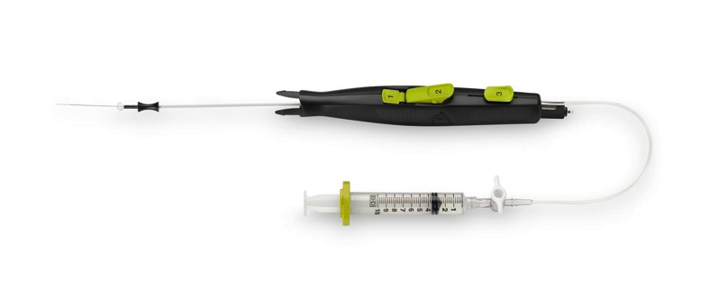

Vascular closure
Figure 15
MynxAce® vascular closure device
Marie-Claude Morice, Maya Riche
©2025 Europa Group - All rights reserved.

