Slide 1


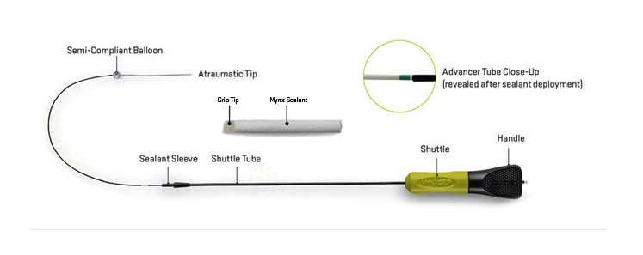

Vascular closure
Figure 16
MynxGrip® vascular closure device
Marie-Claude Morice, Maya Riche
©2025 Europa Group - All rights reserved.

