Slide 1


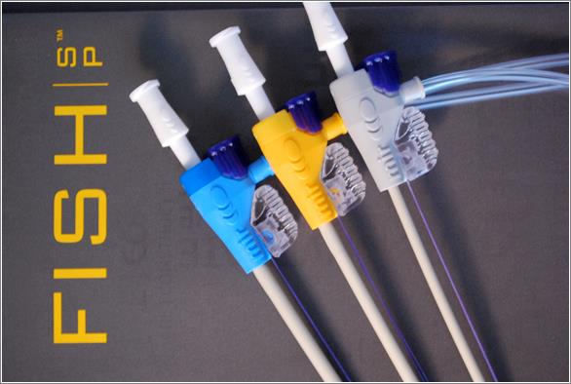

Vascular closure
Figure 17
The Femoral Introducer Sheath and Haemostasis (FISH™) Device
Marie-Claude Morice, Maya Riche
©2025 Europa Group - All rights reserved.

