Slide 1


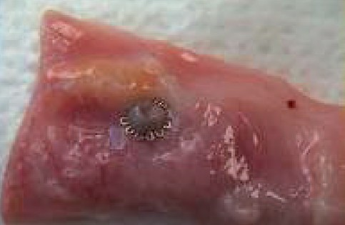

Vascular closure
Figure 18
Position of the nitinol StarClose® clip on the outside of the artery (there is no intravascular portion
Marie-Claude Morice, Maya Riche
©2025 Europa Group - All rights reserved.

