Slide 1


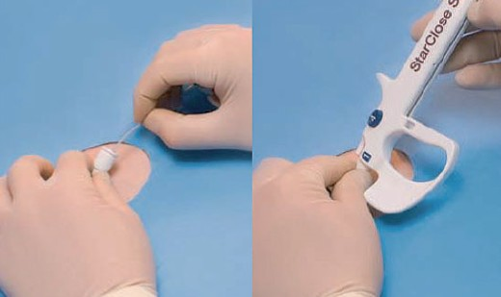

Vascular closure
Figure 19CD
Connect the StarClose exchange sheath to the clip applier – “click 1”
Marie-Claude Morice, Maya Riche
©2025 Europa Group - All rights reserved.

