Slide 1


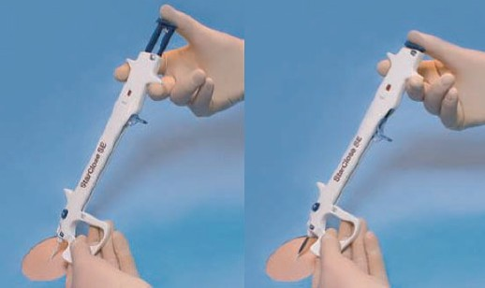

Vascular closure
Figure 19EF
Deploy the locator wings – “click 2”
Marie-Claude Morice, Maya Riche
©2025 Europa Group - All rights reserved.

