Slide 1


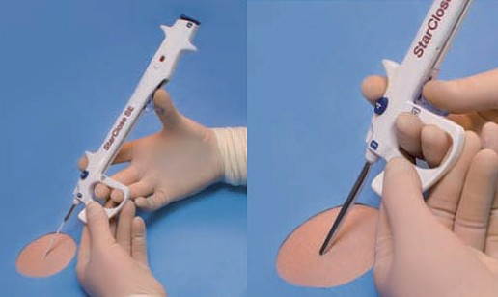

Vascular closure
Figure 19GH
Splitting of the sheath and delivery of the clip to the access site – “click 3”
Marie-Claude Morice, Maya Riche
©2025 Europa Group - All rights reserved.

