Slide 1


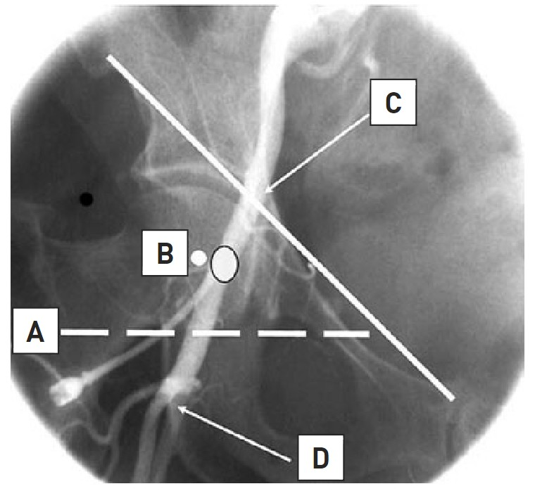

Vascular closure
Figure 1A
Optimal location for femoral artery access. The outlined dot marks the sheath entry site into the common femoral artery (CFA) at the medial aspect of the femoral head in the midline. (A) Inferior border of the femoral head. (C) Line demarcating inguinal ligament running from the anterior superior iliac spine to the pubic symphysis. (D) Bifurcation of CFA into superficial femoral artery and profunda.
Marie-Claude Morice, Maya Riche
©2025 Europa Group - All rights reserved.

