Slide 1


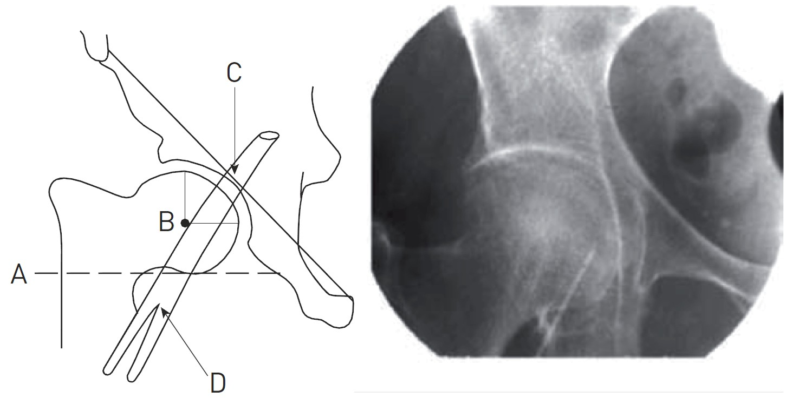

Vascular closure
Figure 1B
Recommended approach: Using fluoroscopy as an adjunct in gaining femoral artery access. Left panel: diagramatic representation of angiographic landmarks. Right panel: puncture needle (arrow) can be seen entering the common femoral artery (CFA) at the optimal location in the medial portion of the midline of the femoral head.
Marie-Claude Morice, Maya Riche
©2025 Europa Group - All rights reserved.

