Slide 1


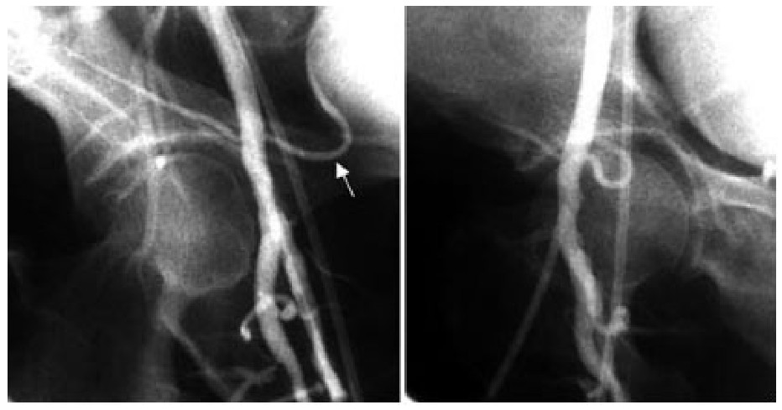

Vascular closure
Figure 1C
Femoral angiography: For a right femoral arteriotomy, the right anterior oblique (RAO) 30/40 degree view (left) nicely lays out the femoral bifurcation and the level of the inferior epigastric artery (arrow), but obscures the sheath entry site. The left anterior oblique (LAO) 30/40 degree view (right) displays the sheath entry site, but the bifurcation is obscured.
Marie-Claude Morice, Maya Riche
©2025 Europa Group - All rights reserved.

