Slide 1


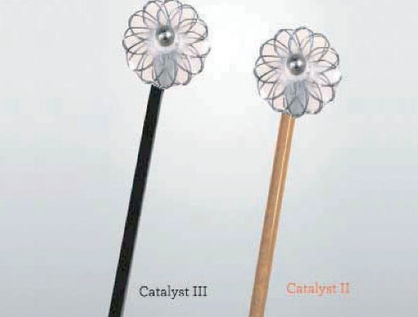

Vascular closure
Figure 21A
Cardiva Catalyst® II and Catalyst III
Marie-Claude Morice, Maya Riche
©2025 Europa Group - All rights reserved.

