Slide 1


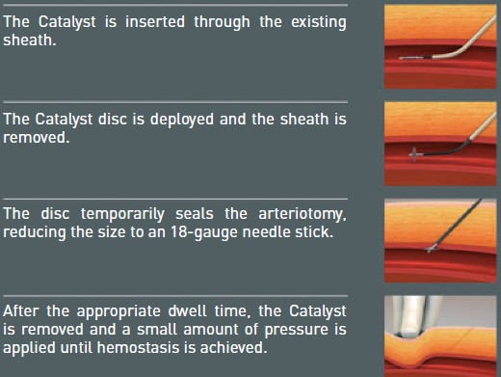

Vascular closure
Figure 21B
Deployment technique for the Cardiva Catalyst®
Marie-Claude Morice, Maya Riche
©2025 Europa Group - All rights reserved.

