Slide 1


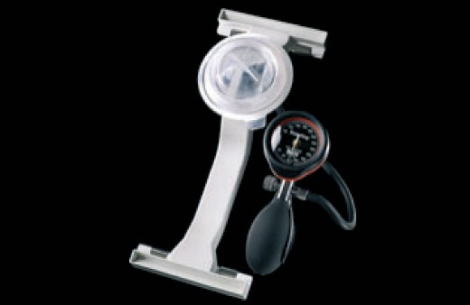

Vascular closure
Figure 24
FemoStop™ compression device
Marie-Claude Morice, Maya Riche
©2025 Europa Group - All rights reserved.

