Slide 1


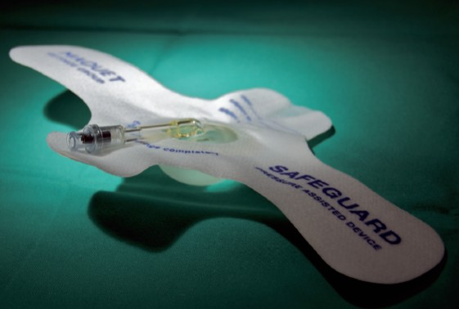

Vascular closure
Figure 25
Safeguard™
Marie-Claude Morice, Maya Riche
©2025 Europa Group - All rights reserved.

