Slide 1


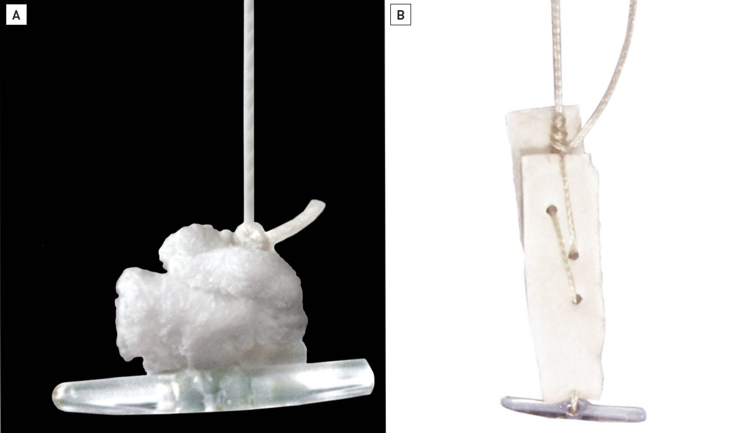

Vascular closure
Figure 3
Angio-Seal™ STS device(A) Undeployed Angio-Seal™ demonstrating the absorbable collagen sponge and the absorbable polymer anchor, connected by an absorbable self-tightening suture (STS).(B) Deployed Angio-Seal™ demonstrating the compressed collagen sponge and anchor forming a tight compressive sandwich.
Marie-Claude Morice, Maya Riche
©2025 Europa Group - All rights reserved.

