Slide 1


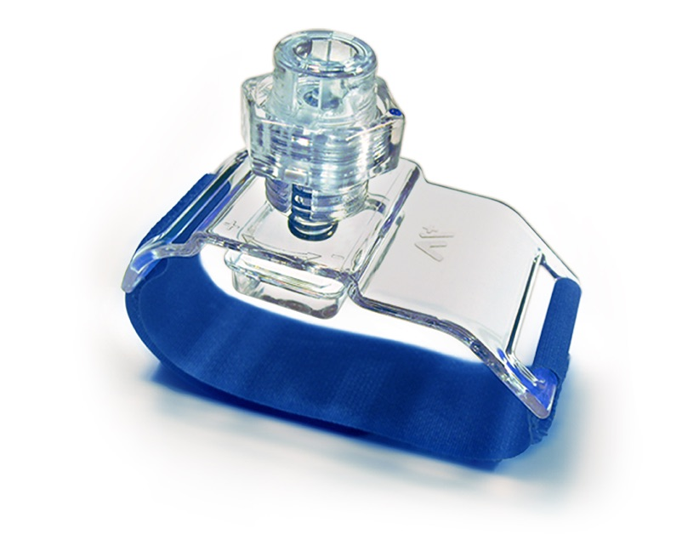

Vascular closure
Figure 30
Helix™ radial compression device
Marie-Claude Morice, Maya Riche
©2025 Europa Group - All rights reserved.

