Slide 1


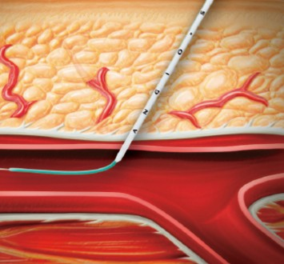

Vascular closure
Figure 4A
The Angio-Seal™ insertion sheath and vessel locator assembly inserted into the femoral artery over a guidewire
Marie-Claude Morice, Maya Riche
©2025 Europa Group - All rights reserved.

