Slide 1


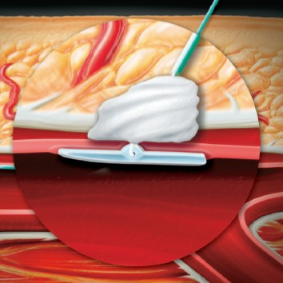

Vascular closure
Figure 4C
The Angio-Seal™ collagen plug is pushed gently into the tissue tract using the tamper tube
Marie-Claude Morice, Maya Riche
©2025 Europa Group - All rights reserved.

