Slide 1


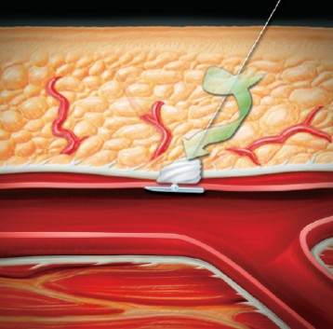
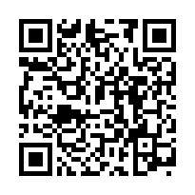
Vascular closure
Figure 4D
The Angio-Seal™ collagen plug twists as it is pushed into the tissue tract
Marie-Claude Morice, Maya Riche
©2025 Europa Group - All rights reserved.

