Slide 1


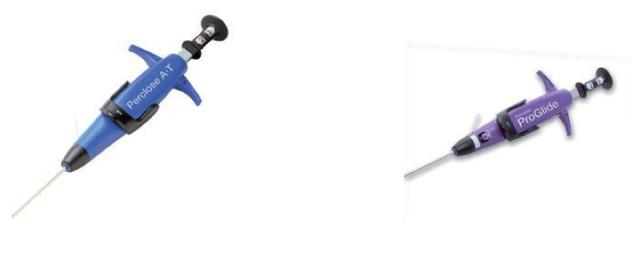

Vascular closure
Figure 6
Perclose ® devices
Marie-Claude Morice, Maya Riche
©2025 Europa Group - All rights reserved.

