Slide 1


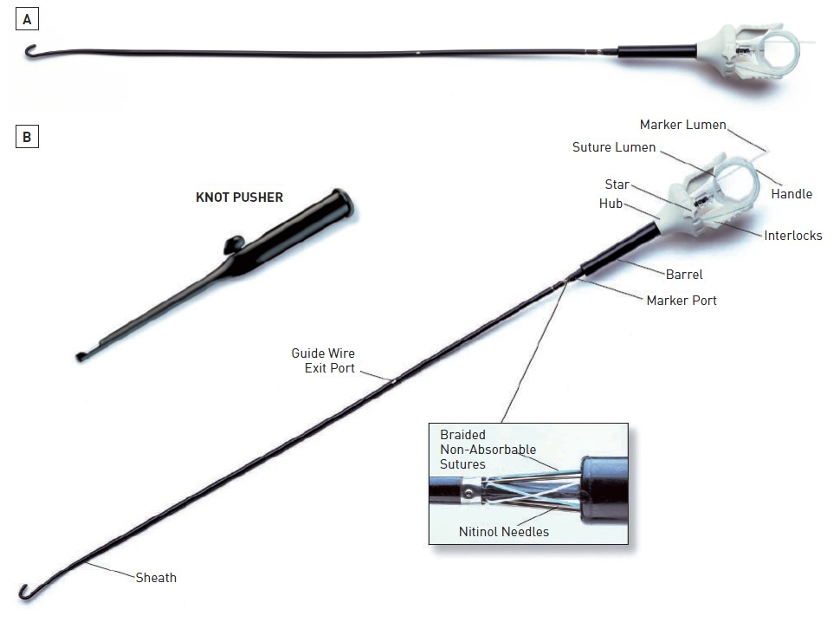

Vascular closure
Figure 8
The Abbott Prostar® XL Percutaneous Suture-Mediated Closure Device. (A) Prostar XL 10F device. (B) Knot pusher and inner components showing the needles with respect to the suture and needle guide.
Marie-Claude Morice, Maya Riche
©2025 Europa Group - All rights reserved.

