Slide 1


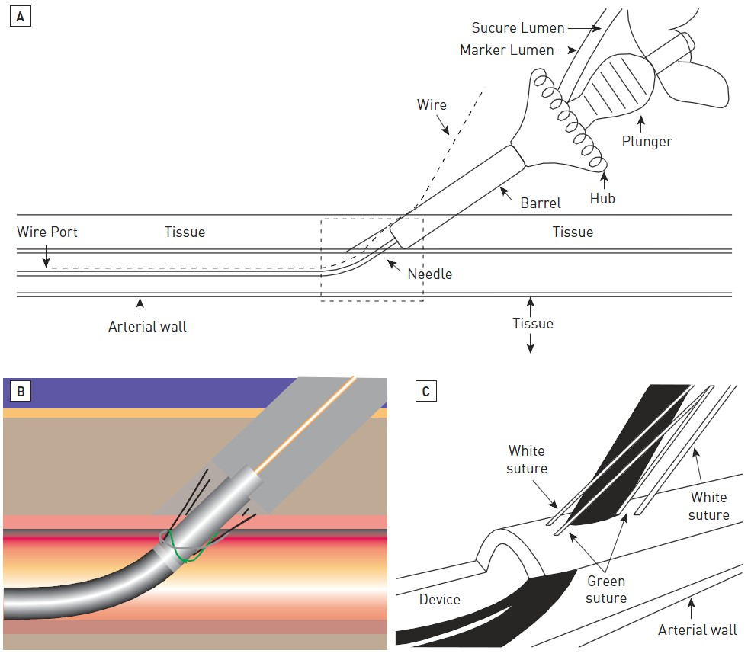

Vascular closure
Figure 9
Deployment of the Abbott Prostar® XL Percutaneous Suture-Mediated Closure Device(A) Schematic of the Prostar XL device, maintaining a 45-degree angle during deployment; (B) Cartoon depiction of device deployment showing the green and white sutures penetrating the arterial wall; (C) Drawing of the green and white sutures as they penetrate the arterial wall following deployment.
Marie-Claude Morice, Maya Riche
©2025 Europa Group - All rights reserved.

