Slide 1


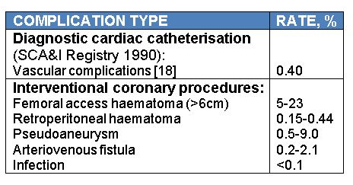

Vascular closure
Table 1
Femoral access complication rates [16]
Marie-Claude Morice, Maya Riche
©2025 Europa Group - All rights reserved.

