Slide 1


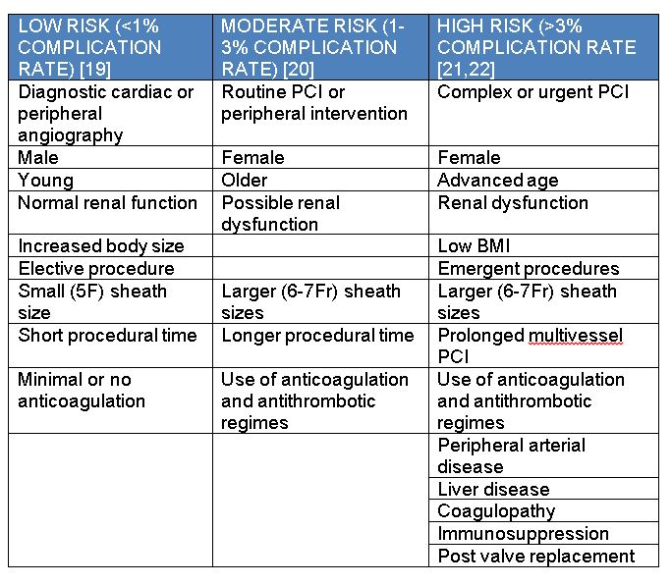

Vascular closure
Table 2
Clinical determinants of vascular complication rates
Marie-Claude Morice, Maya Riche
©2025 Europa Group - All rights reserved.

