Slide 1


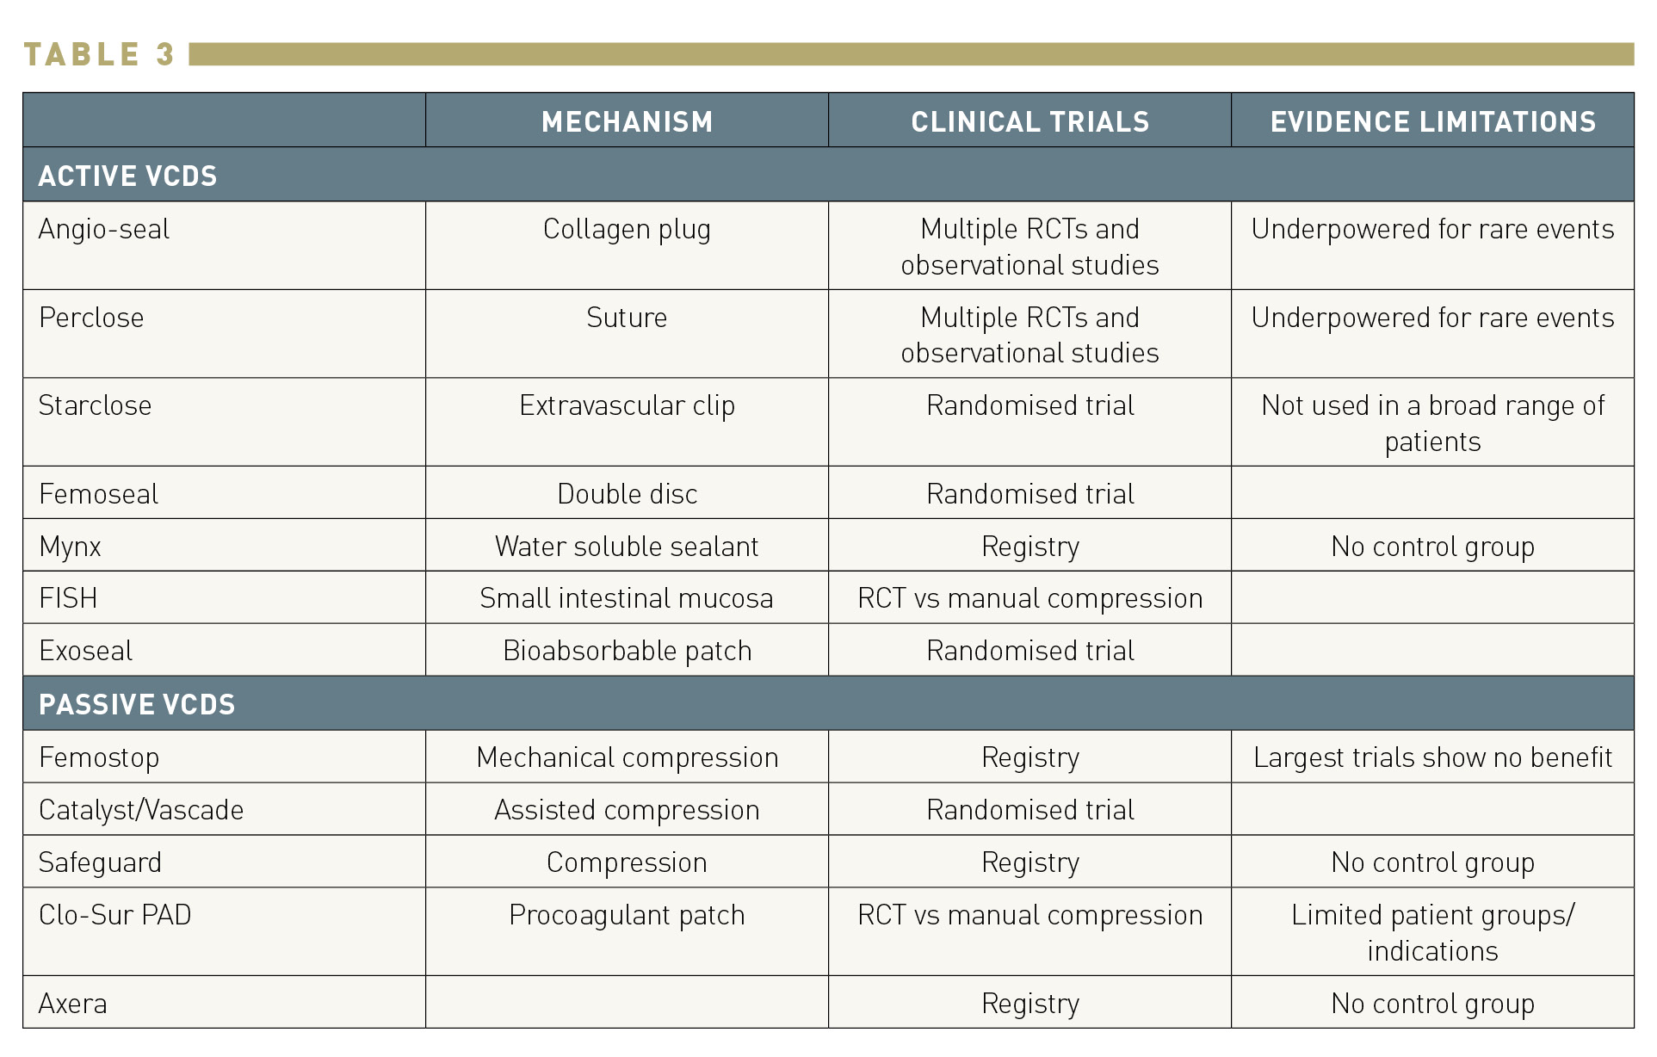

Vascular closure
Table 3
Classification of VCDs
Marie-Claude Morice, Maya Riche
©2025 Europa Group - All rights reserved.

