Slide 1


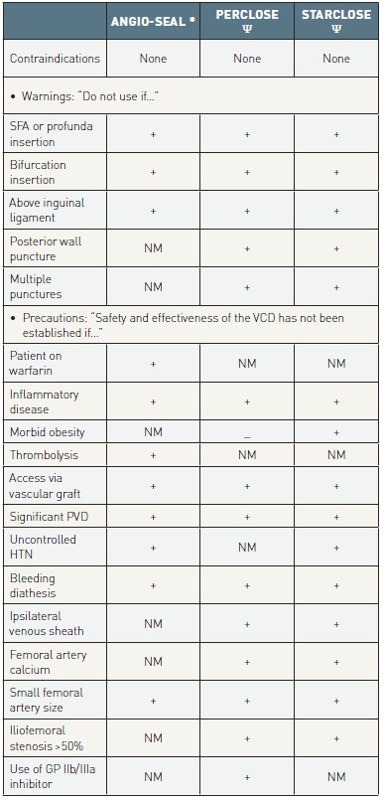

Vascular closure
Table 5
Contraindications and precautions for VCD use*Instructions for Use: Angio-Seal VIP, St. Jude Medical, February 2006 (www.sjm.com); ψ Instructions for Use: Perclose AT (August 2006) and StarClose (February 2007), Abbott Vascular (www.abbot-tvascular.com/ifu).GP: glycoprotein; HTN: hypertension; NM: not mentioned in instructions for use as warning or caution; PCI: percutaneous coronary intervention; PVD: peripheral vascular disease; SFA: superficial femoral artery; VCD: vascular closure device; +: explicitly mentioned in instructions for use as warning or caution.
Marie-Claude Morice, Maya Riche
©2025 Europa Group - All rights reserved.

