Slide 1


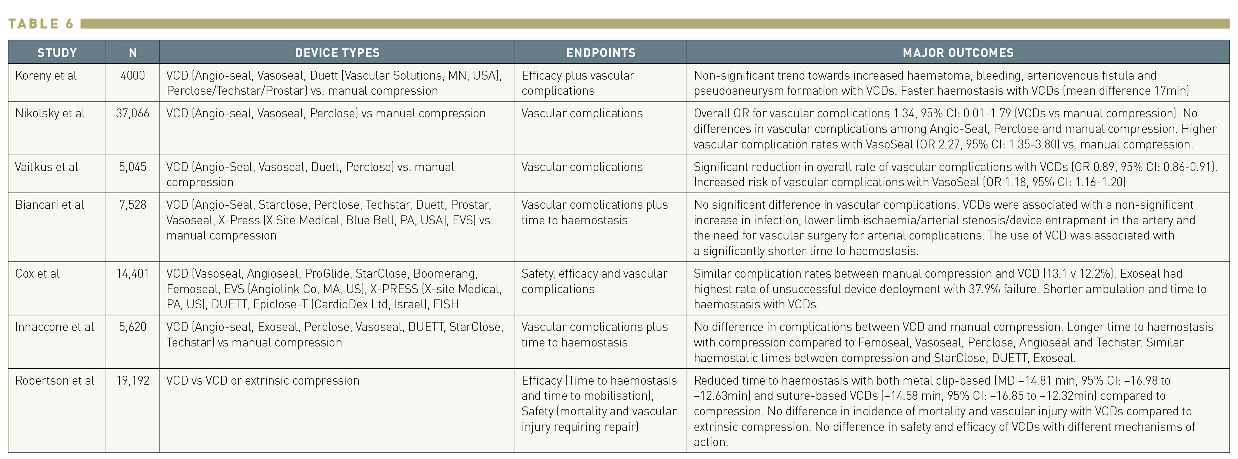

Vascular closure
Table 6
Summary of meta-analyses
Marie-Claude Morice, Maya Riche
©2025 Europa Group - All rights reserved.

