Slide 1


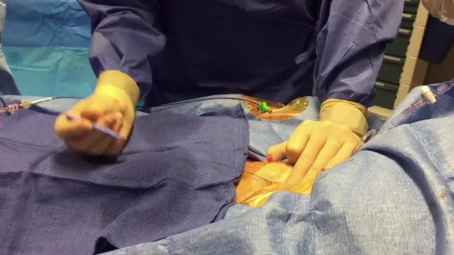

Vascular closure
Video 1
Preclosure technique using two Proglides prior to TAVI insertion.
Marie-Claude Morice, Maya Riche
©2025 Europa Group - All rights reserved.

